Slide 1

Perceptron Implementation using Python Numpy
Professor Jonathan Loo
Chair in Computing and Engineering
School of Engineering and Computing
University of West London

Slide 2
Lesson Outline
Anaconda
Google Colab
Perceptron Implementation – Binary Classifier
Wheat Seeds - Binary Classifier
Imports important libraries for mathematical operations
Dataset analysis and visualisation
Pre-processing dataset for neural network learning
Neural network model setup and parameters initialisation
Hyper-parameters configuration and neural network training
Neural network prediction performance evaluation
Notes:
http://rinterested.github.io/statistics/softmax.html

Slide 3
Anaconda Setup

Slide 4

Anaconda Navigator
Anaconda is a open-source distribution of the Python and R programming languages for scientific computing (data science, machine learning applications, large-scale data processing, predictive analytics, etc.), that aims to simplify package management and deployment.

Slide 5
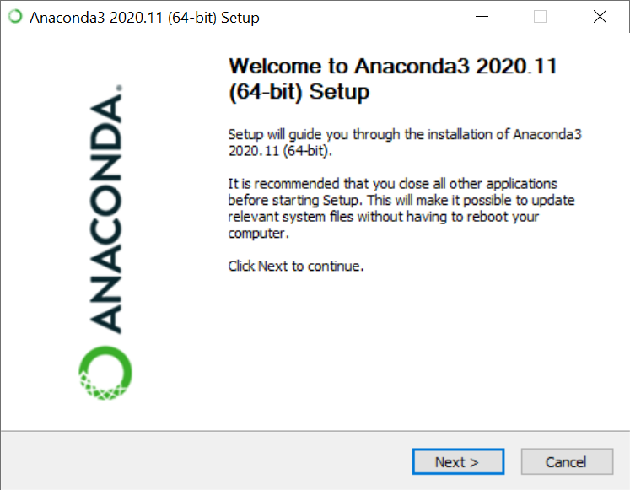
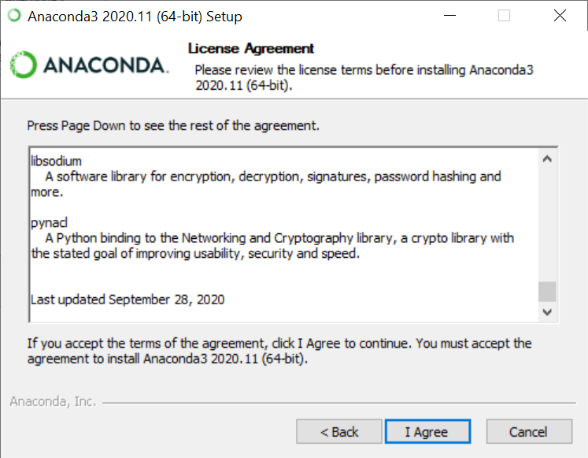
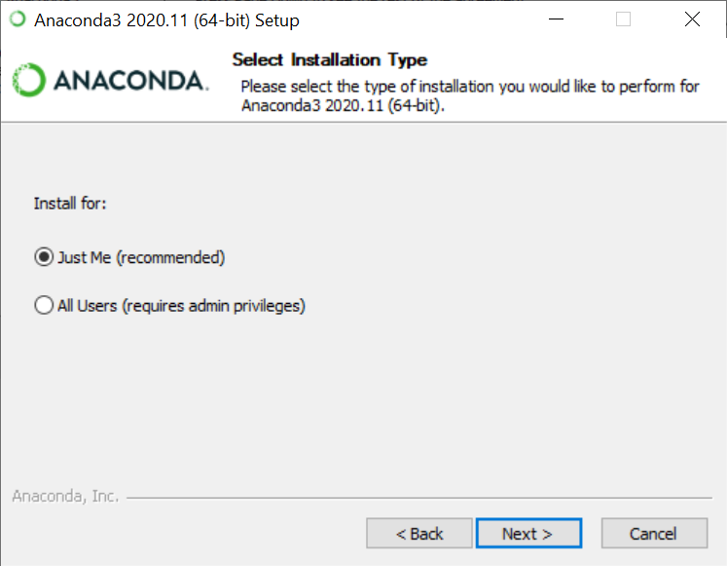
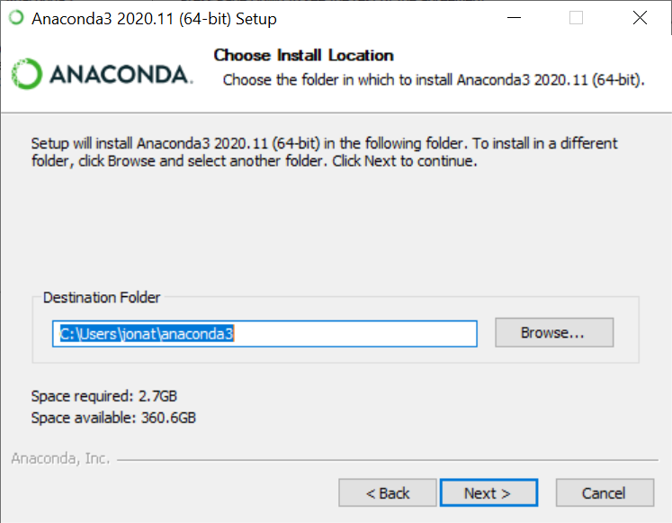
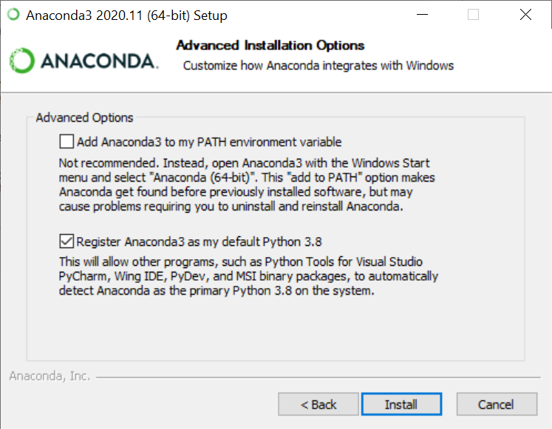
Anaconda Setup

Slide 6
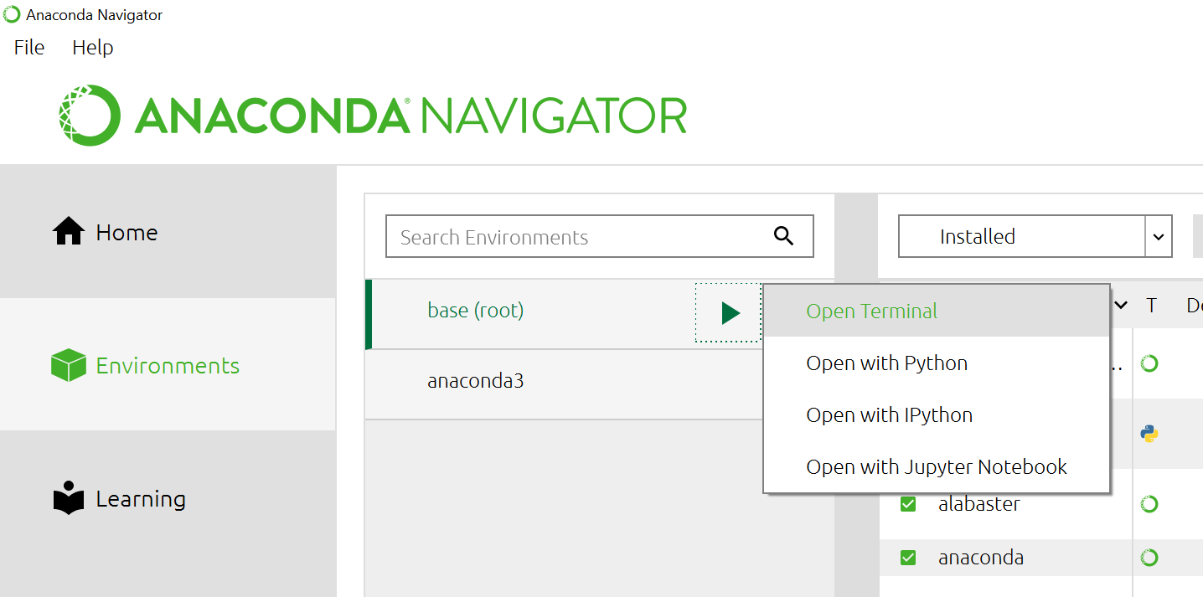
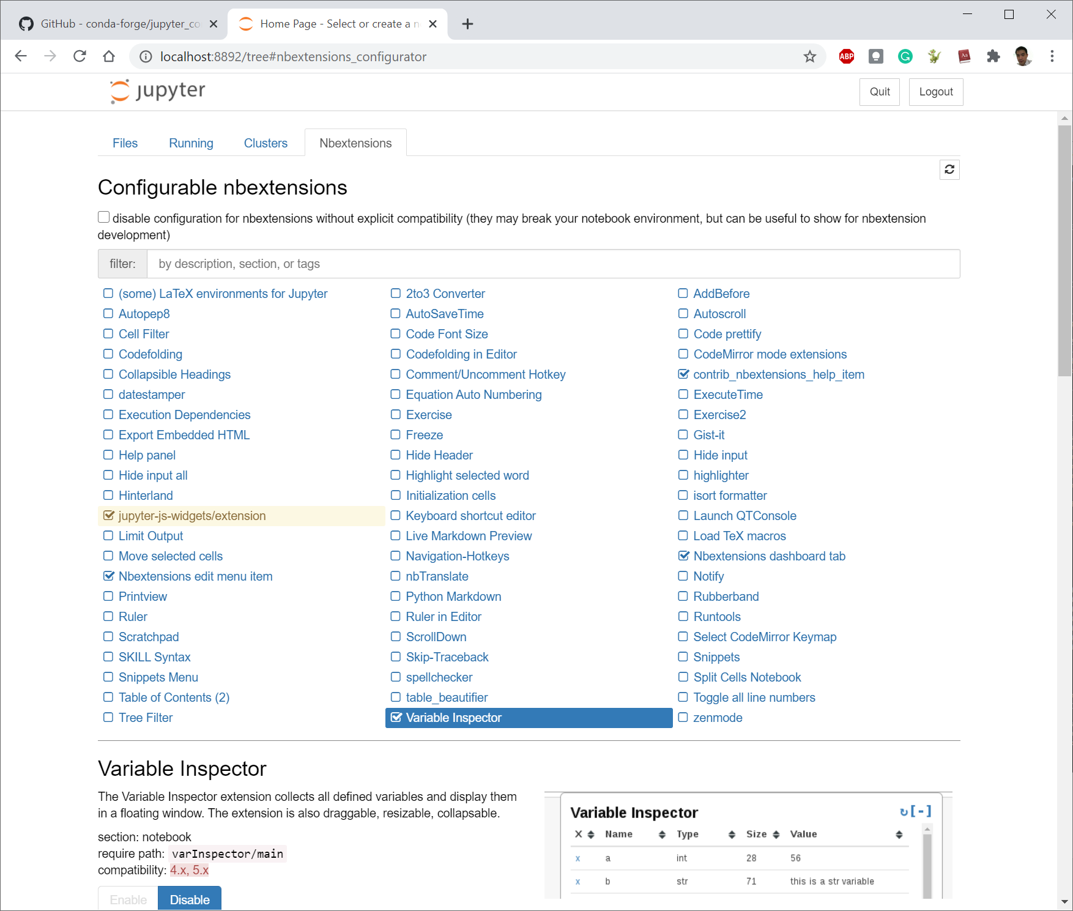
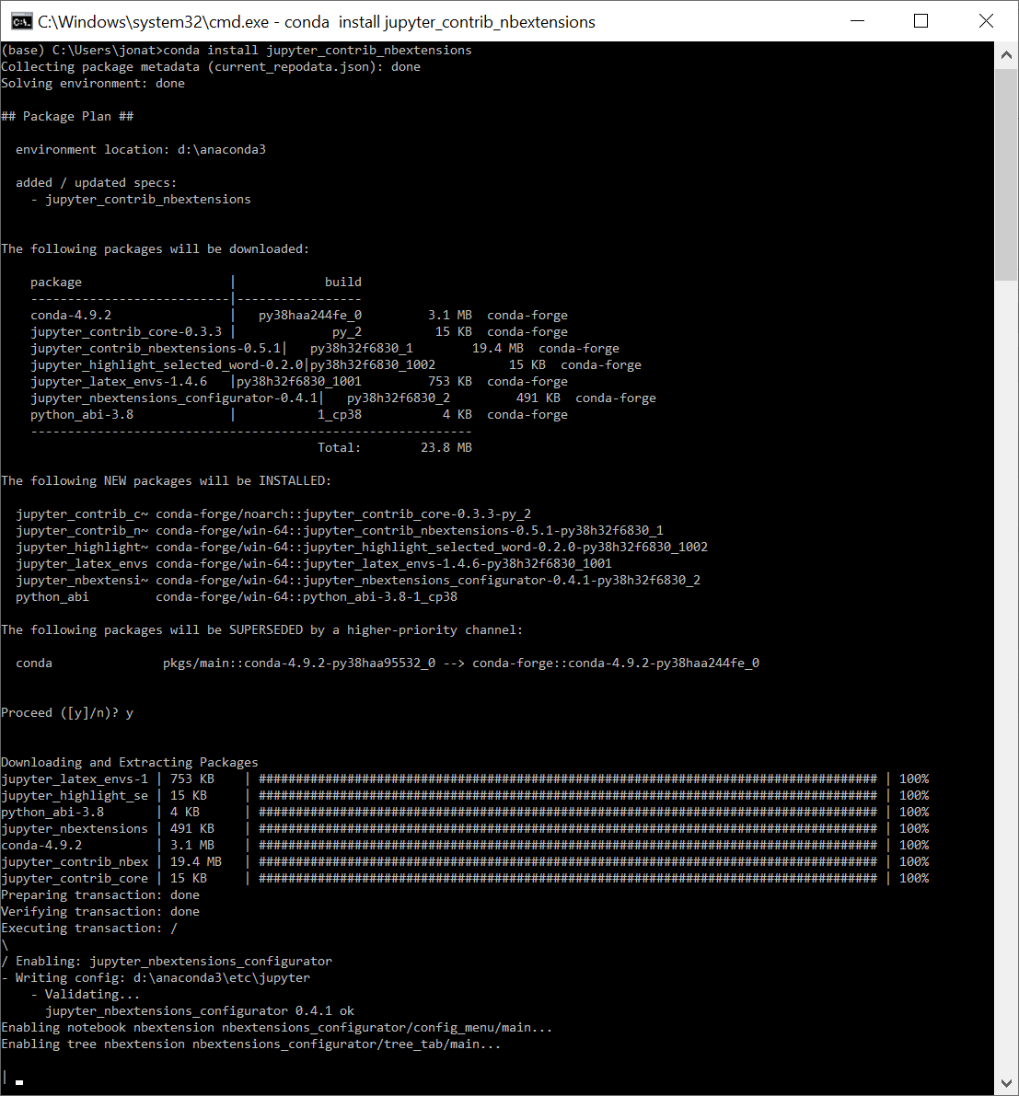
Anaconda Setup: Variable Inspector

Slide 7
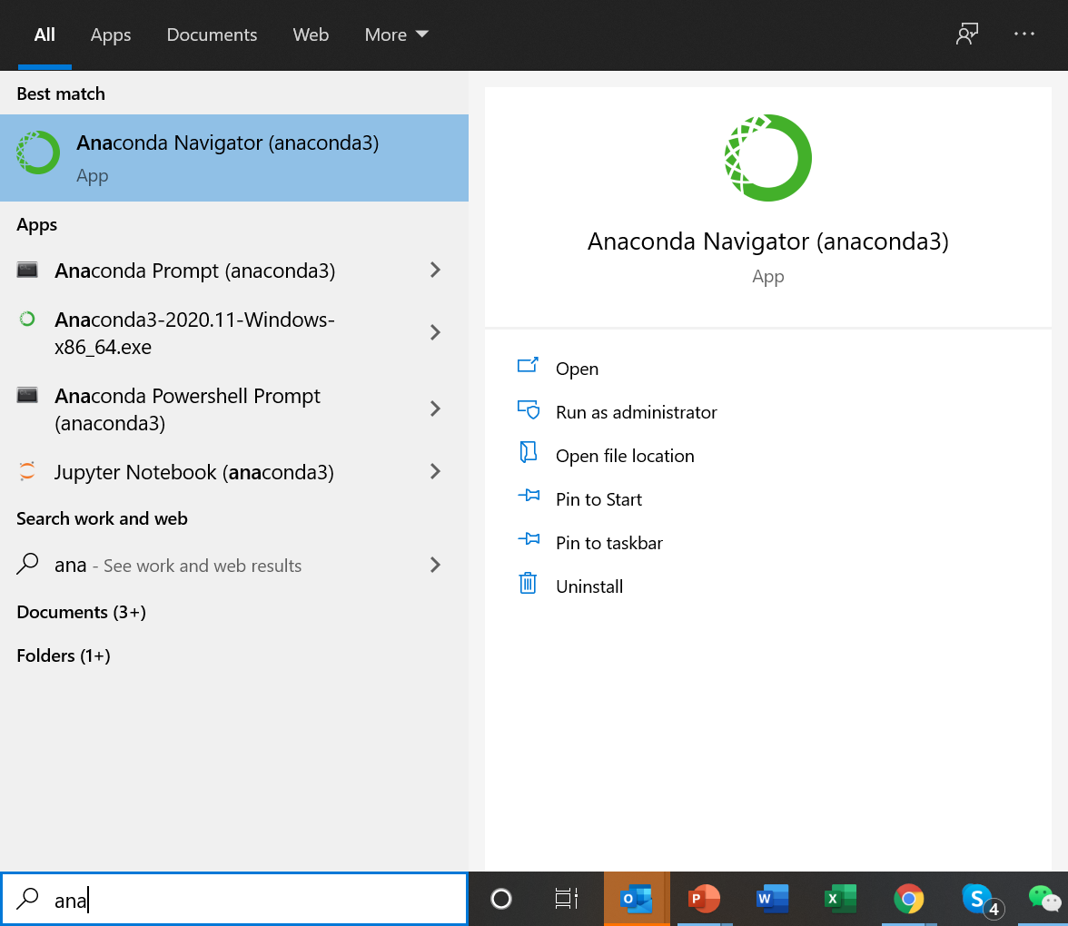
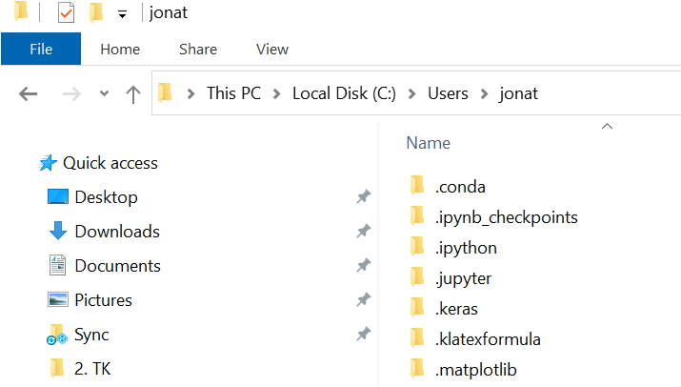
Accessing Anaconda
Anaconda’s main folder is in your local user’s folder. Shown below is my main user folder:

Slide 8
Google Colab Setup

Slide 9
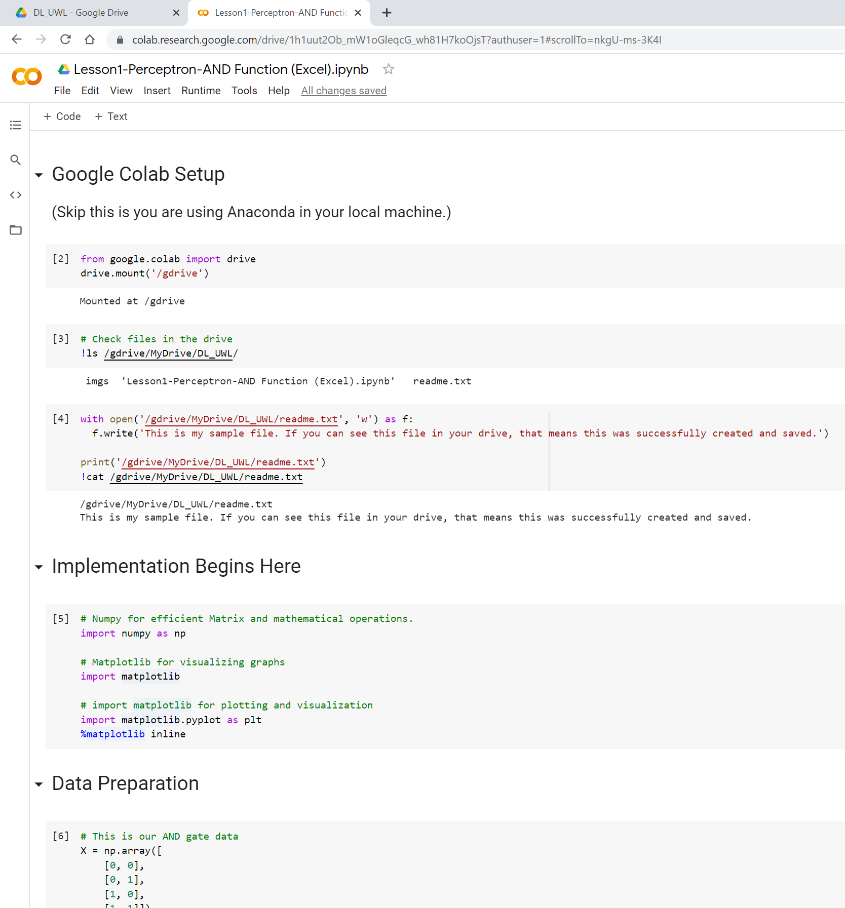
Google Colab Setup
In order to use Google Colab effectively and efficiently, you requires Google Drive where the Jupyter Notebook (Python programme), dataset and other files are stored.
To access those important files, we will have to mount your Good gle drive as shown here.

Slide 10
Perceptron Machine Learning Implementation with Python NumPY
AND function approximation

Slide 11
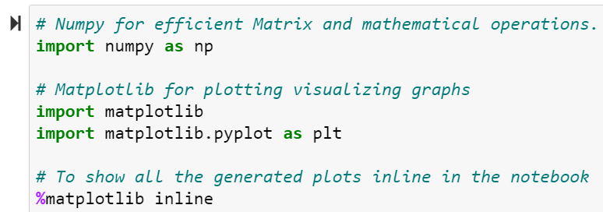
Python, Libraries and Imports
Our objective is to build a neural network (Perceptron) code using Python from scratch (without using pre-build libraries like Pytorch and Keras).
We will be using some fundamental libraries as follows:
NumPy is a library for the Python programming language, adding support for large, multi-dimensional arrays and matrices, along with a large collection of high-level mathematical functions to operate on these arrays.
Matplotlib is a plotting library for the Python and its numerical mathematics extension NumPy.
Pyplot is a Matplotlib module which provides a MATLAB-like interface.[10] Matplotlib is designed to be as usable as MATLAB, with the ability to use Python, and the advantage of being free and open-source.

Slide 12
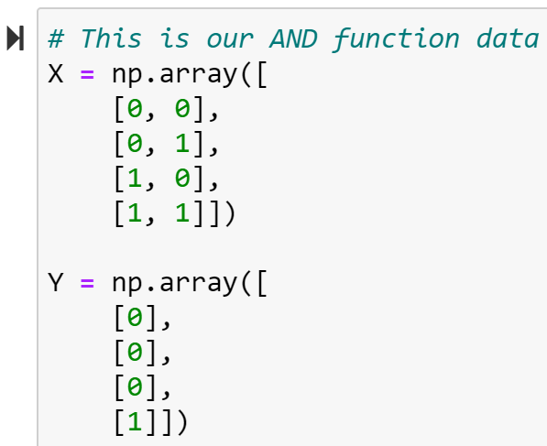
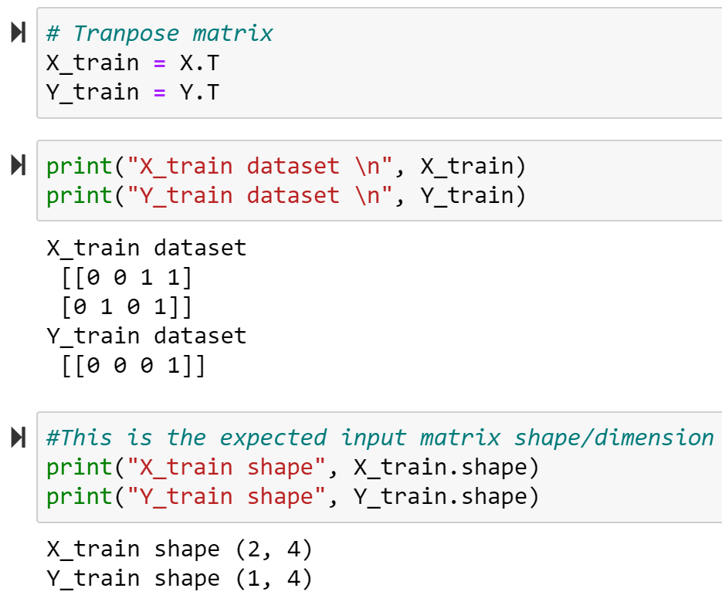
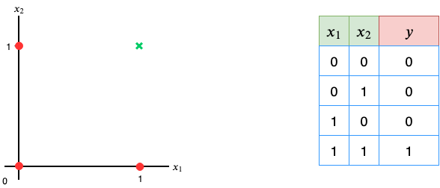
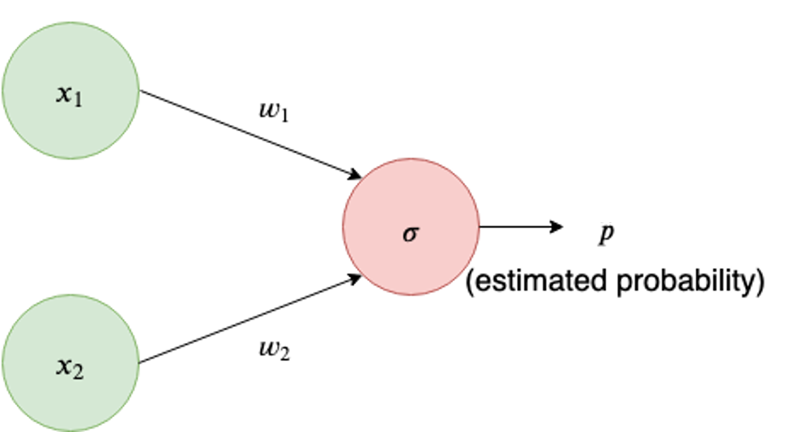
Data Preparation (AND function problem)

Slide 13
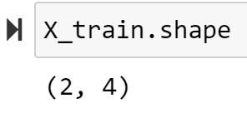
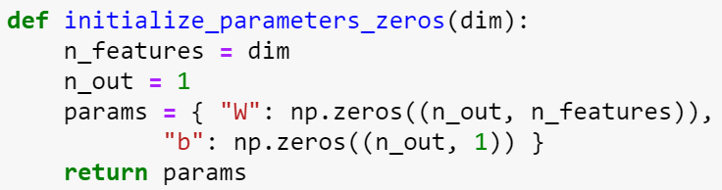
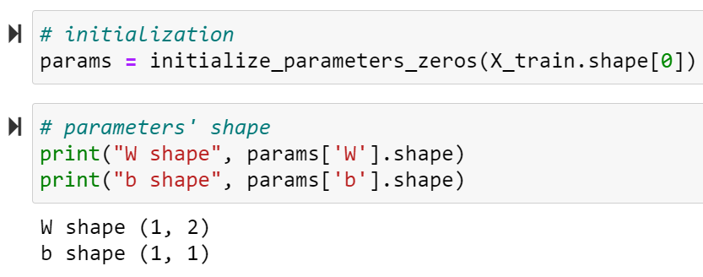
Neural Network Functions
You can write your code as a Python function. A set of python functions can be included in a module file with the file extension .py, and called into a main program using Import command.
NumPy function to generate zeros in array of a defined shape
Return statement used inside a function or method to send the function's result back to the caller.
This is to print out the matrix dimension of the parameters weights, to ensure the right dimension.
Dictionaries are used to store data values in key:value pairs. A dictionary is a collection which is unordered, changeable and does not allow duplicates.
Result of the print command, showing the matrix dimension of the parameters

Slide 14
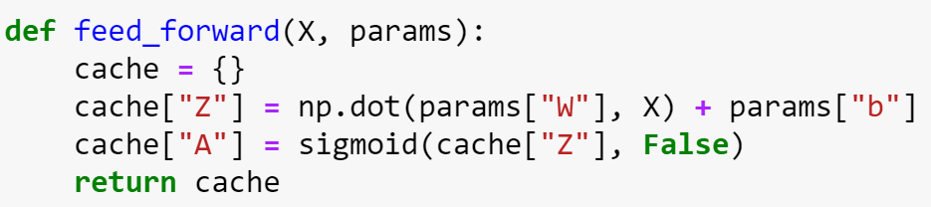
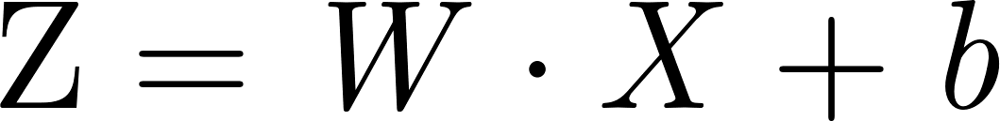

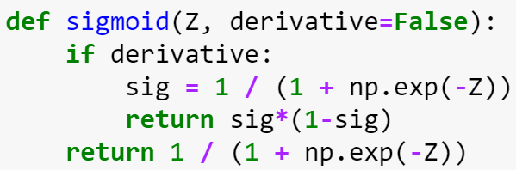
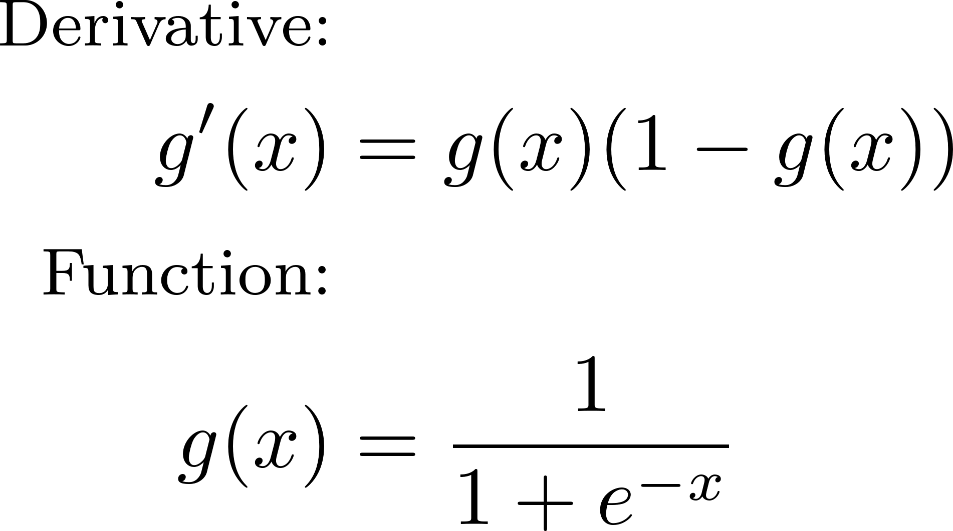
Neural Network Functions
You can write your code as a Python function. A set of python functions can be included in a module file with the file extension .py, and called into a main program using Import command.
Dictionaries are used to store data values in key:value pairs. A dictionary is a collection which is unordered, changeable and does not allow duplicates.
NumPy function: np.dot is the product of two arrays. Np.matmul is the matrix product of two arrays can also be used.
https://numpy.org/doc/stable/reference/generated/numpy.matmul.htm
Linear affine transformation
Activation function
Sigmoid function and its derivative

Slide 15
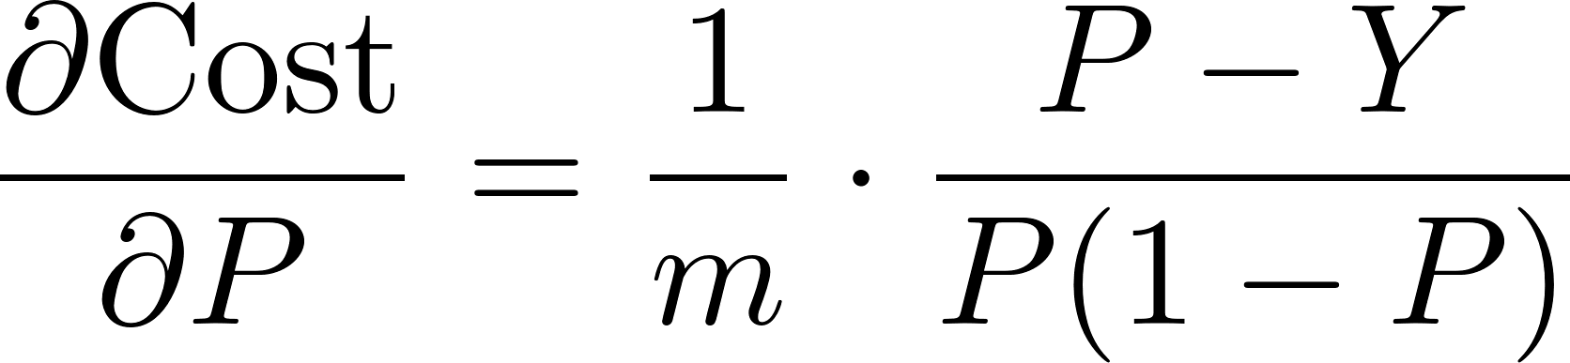

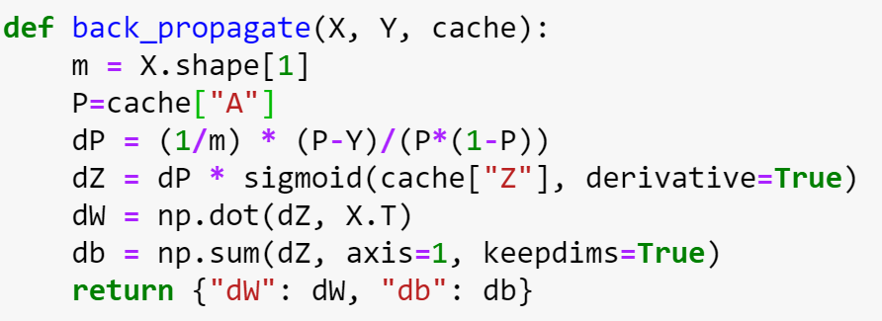
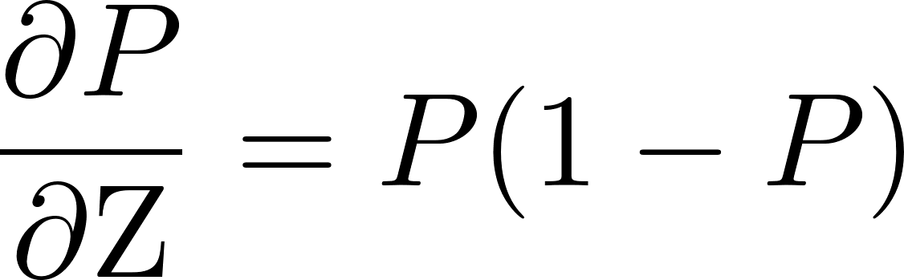
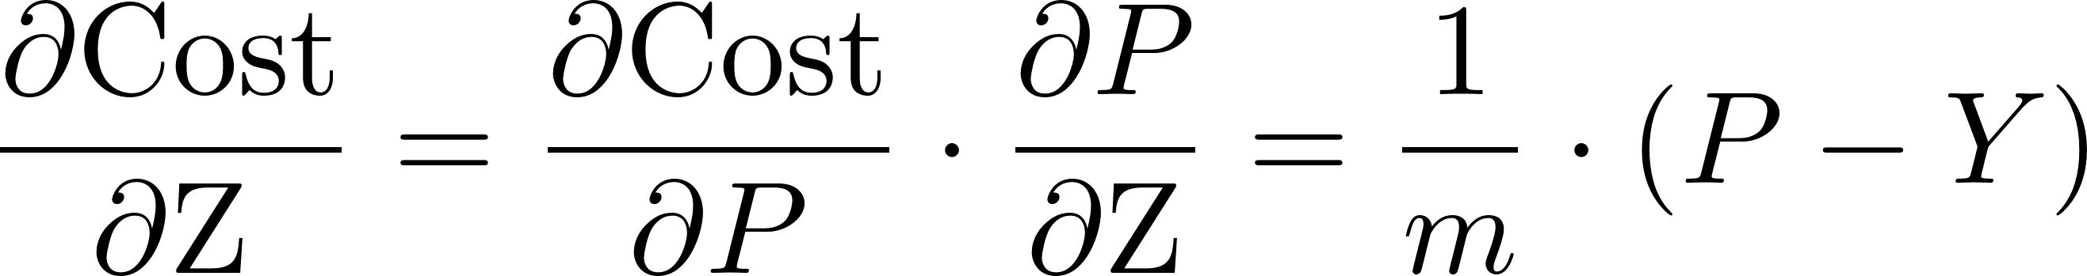
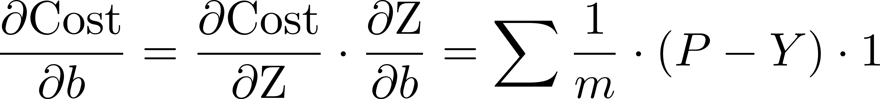
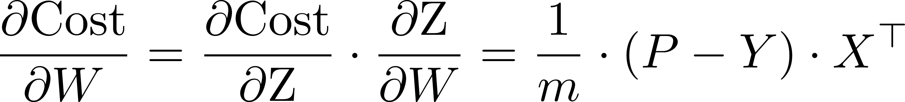
Neural Network Functions
Derivative of Cost w.r.t P
This step is only to aid better understanding.
Derivative of Sigmoid w.r.t its input (Z)
Derivative of Cost w.r.t Z
Sum of array elements over a given axis where axis=0 summing column-wise, and axis=1 summing row-wise.
The gradient of the parameters is stored in dictionary in return.
Derivative of Cost w.r.t b
Derivative of Cost w.r.t W

Slide 16
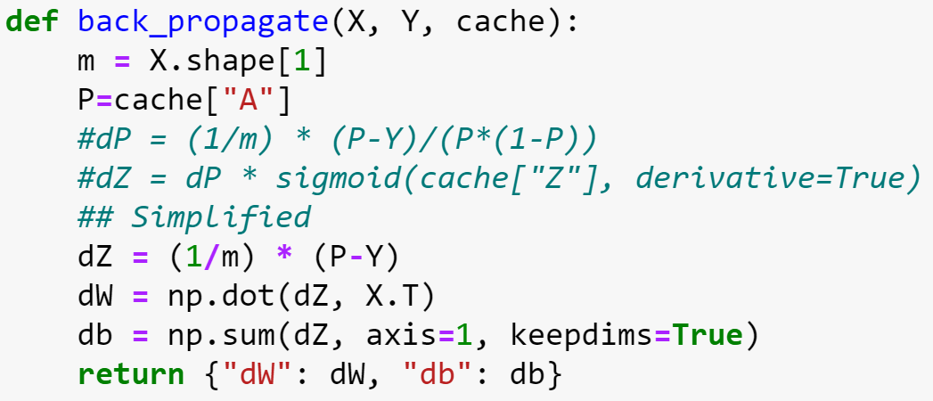
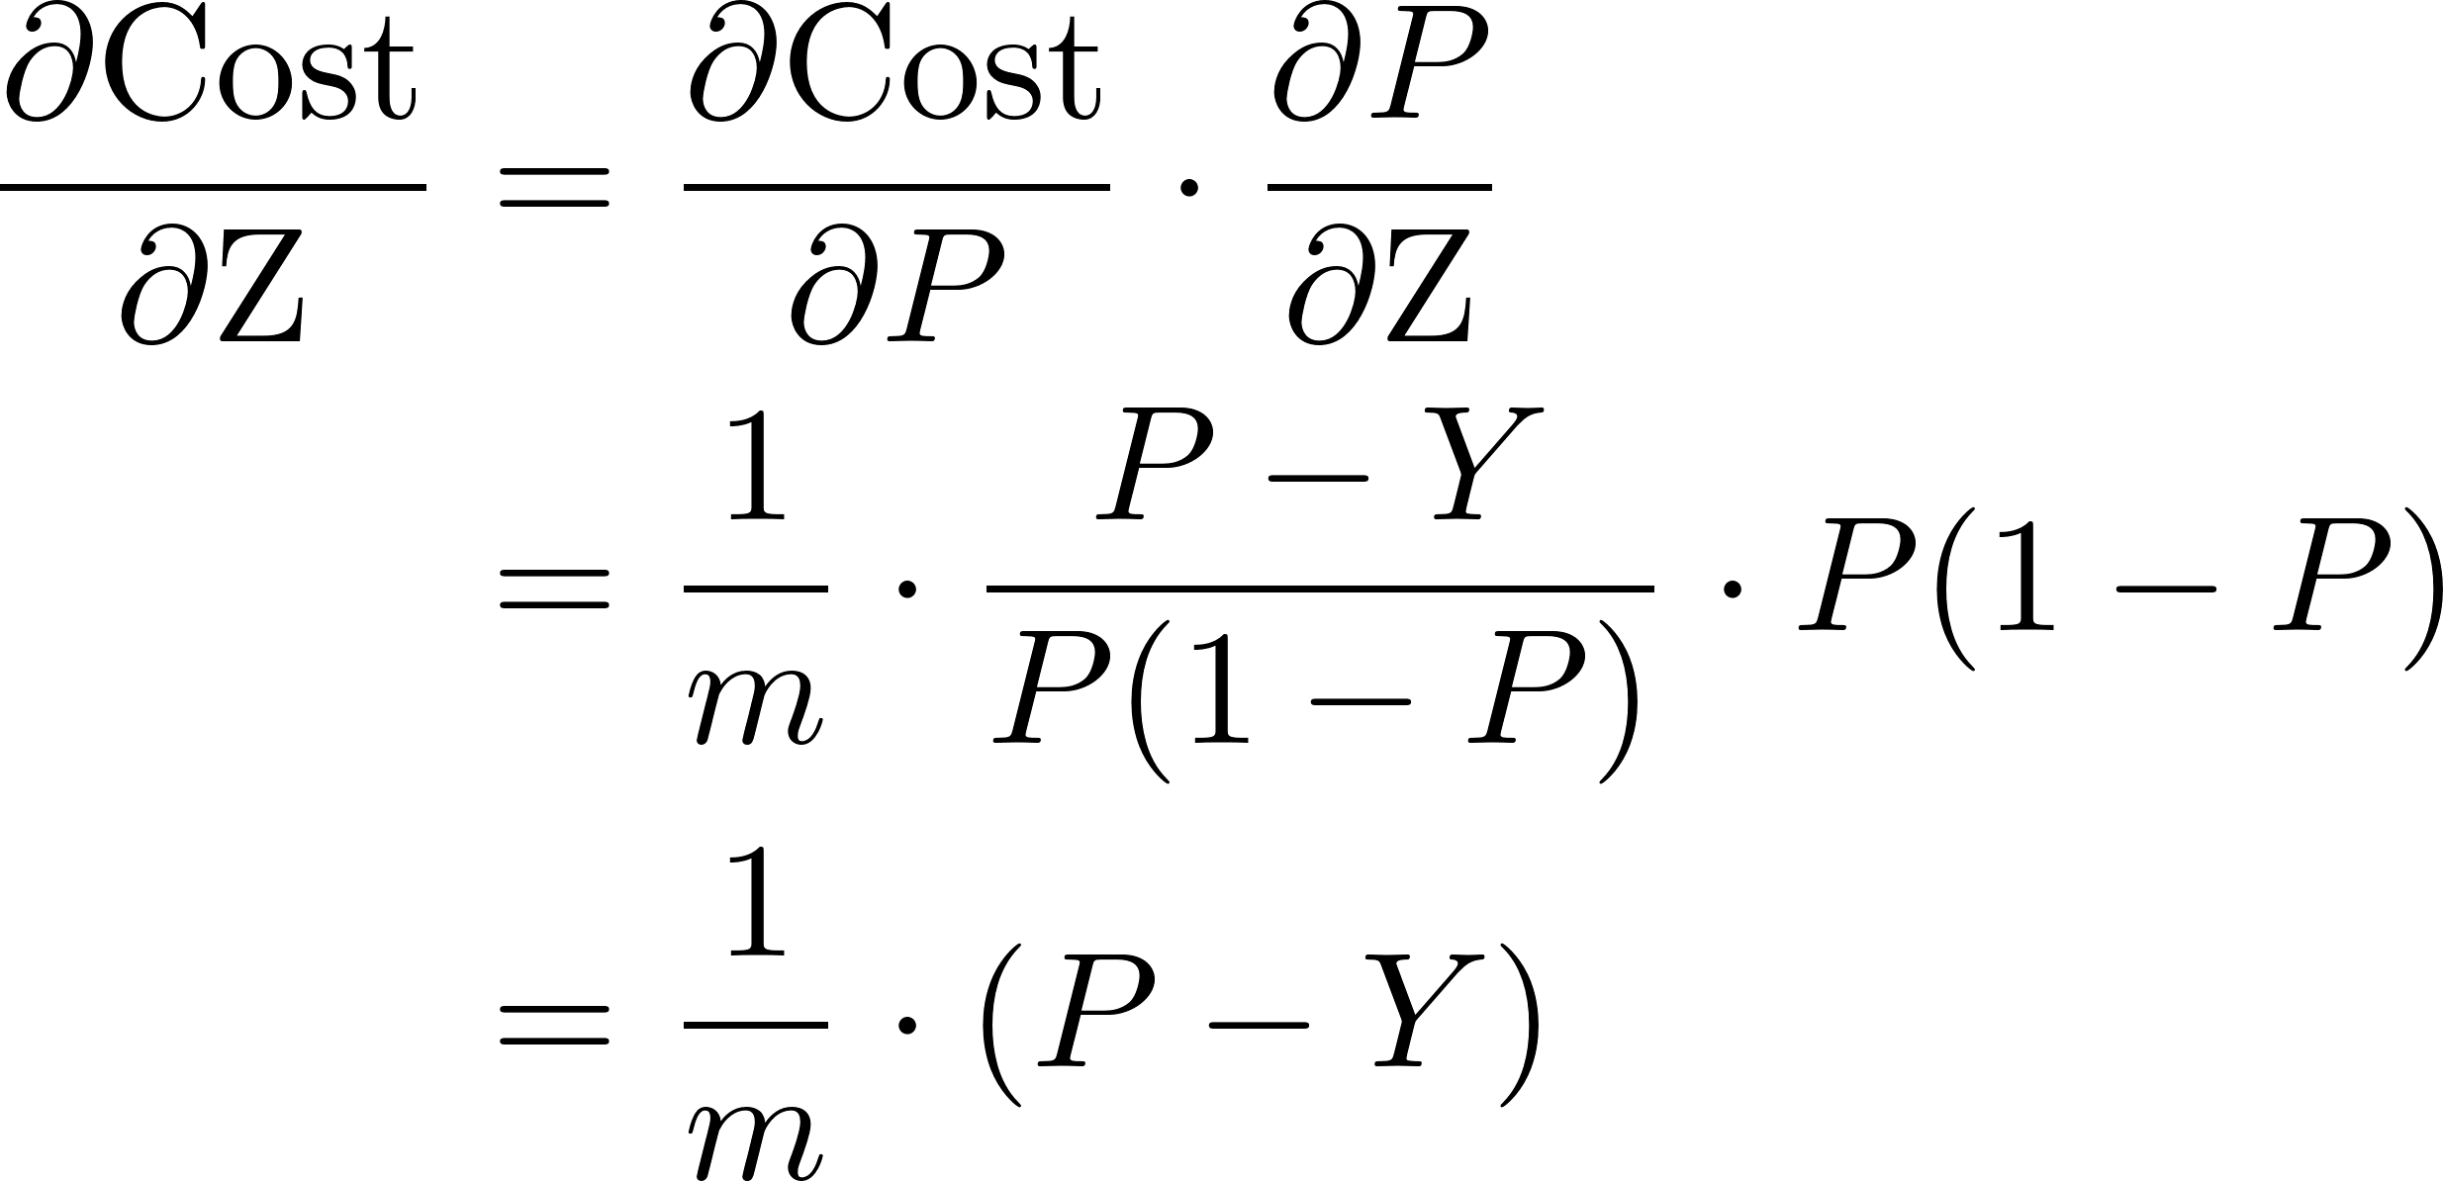
Neural Network Functions
Derivative of Cost w.r.t P
Derivative of Sigmoid w.r.t its input (Z)
Derivative of Cost w.r.t Z

Slide 17
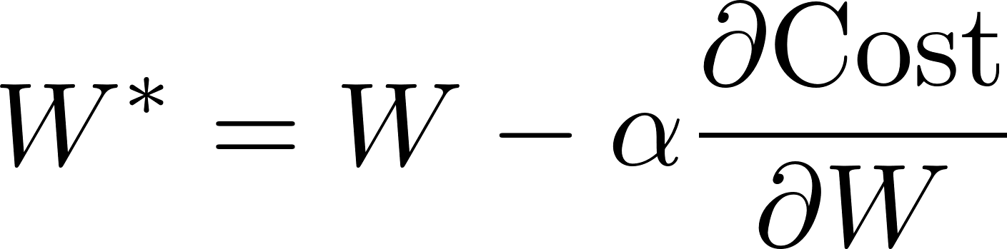
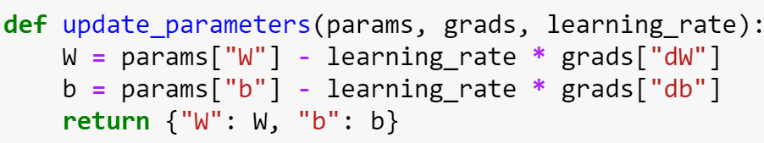
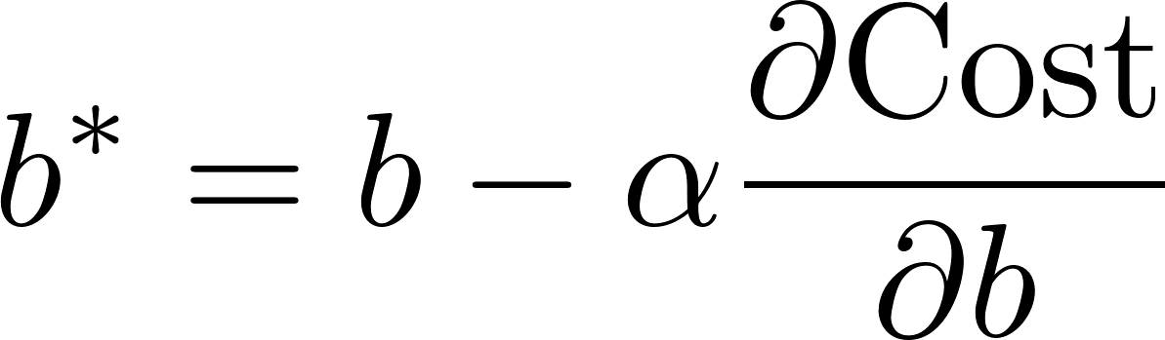
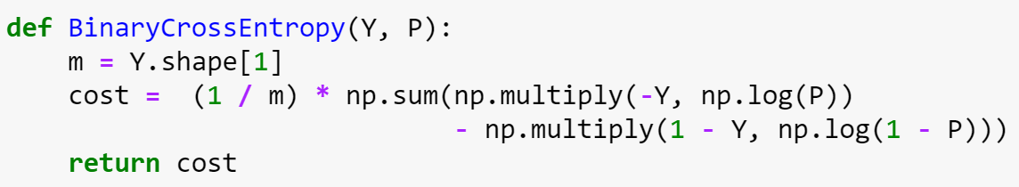
Neural Network Functions

Slide 18
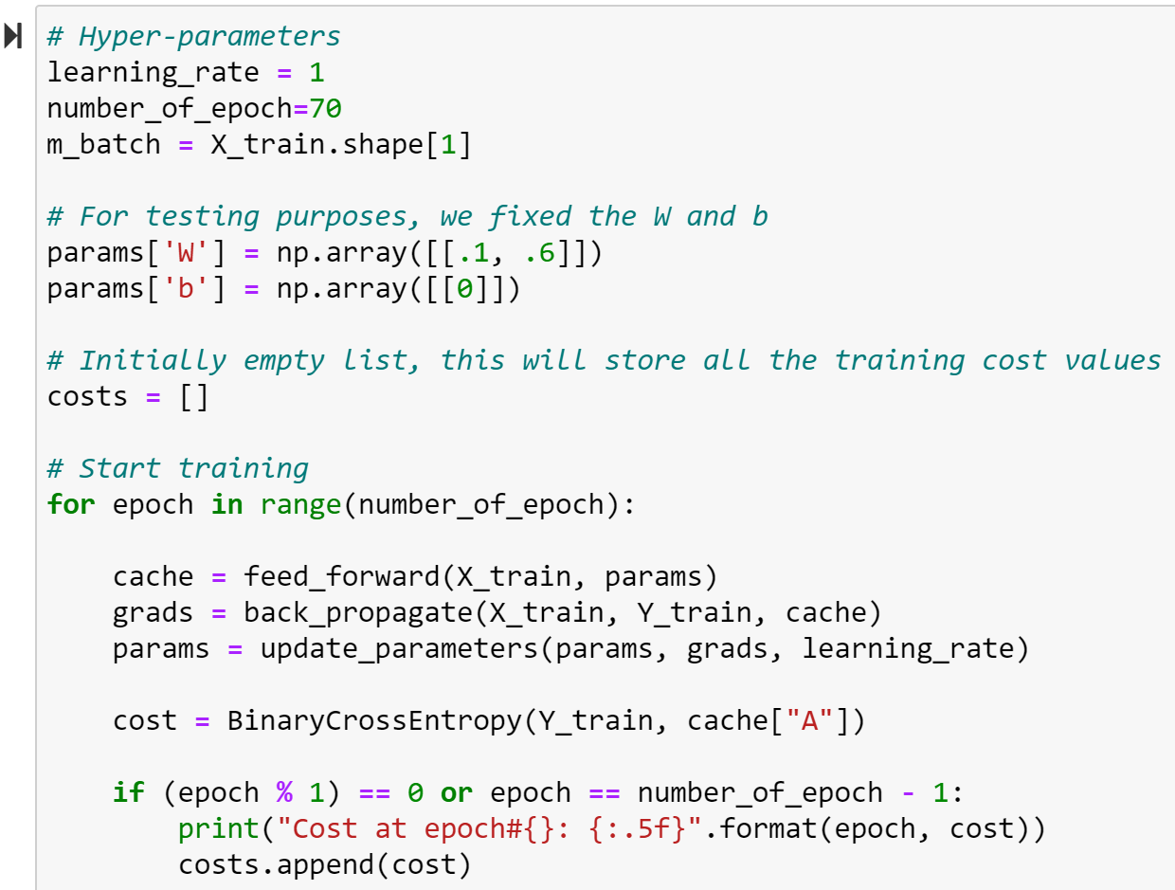
Neural Network Training Setting
Hyper-parameters are a set of settings for neural network training
These fixed parameter values are setup to verify our Microsoft Excel implementation
Neural network functions are called in a training loop
Print the Epoch and Cost at every interaction

Slide 19
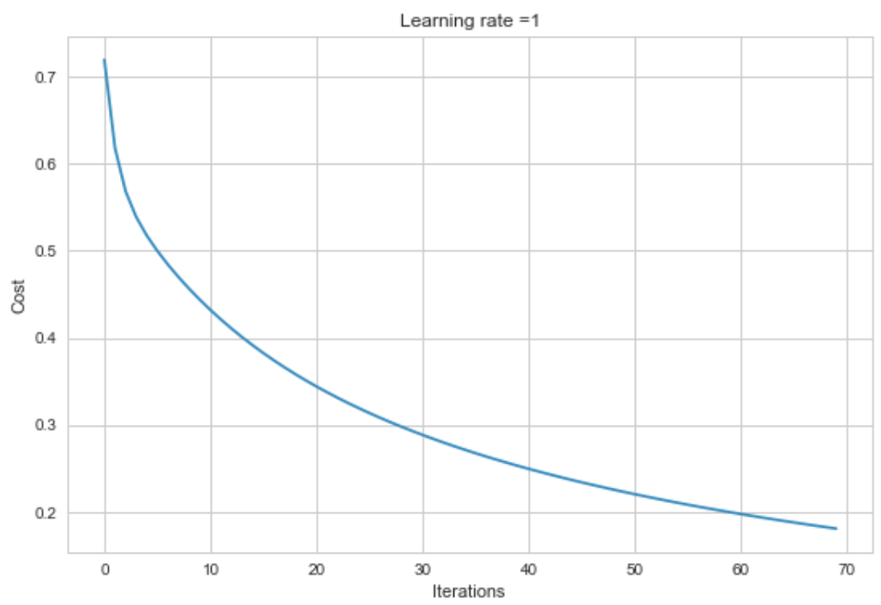
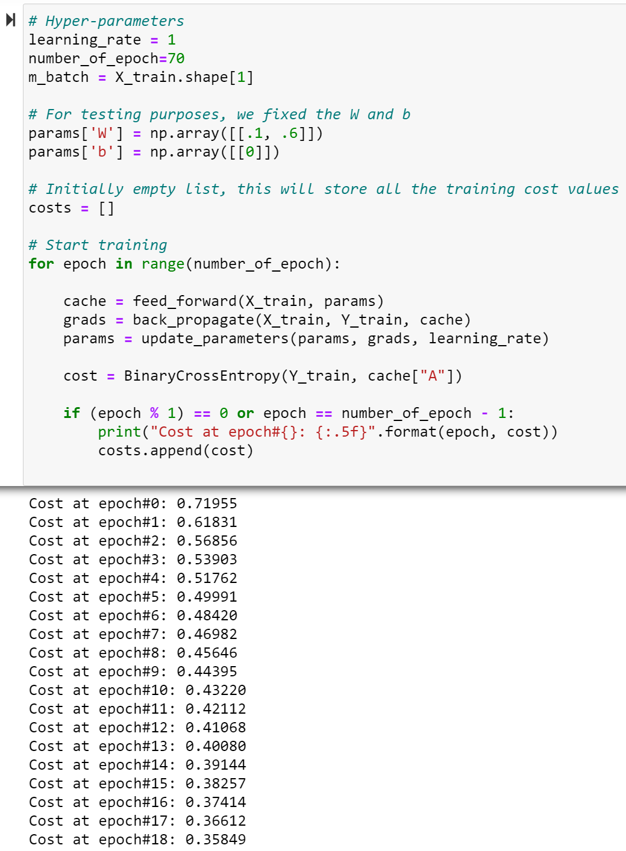
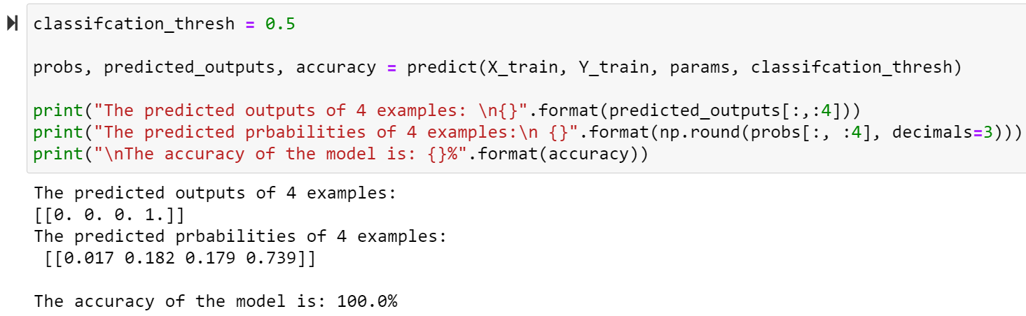
Neural Network Training Result

Slide 20
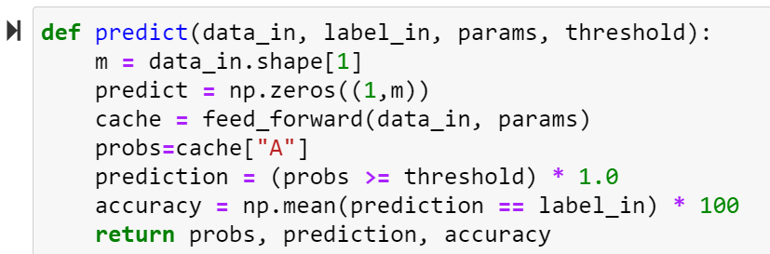
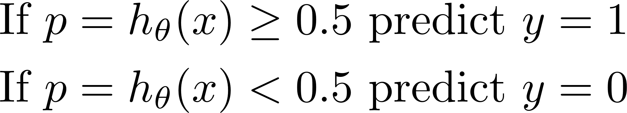
Performance Evaluation: Calculate Model’s Accuracy
This function is created to calculate the accuracy of the model. The parameters previously trained is used here for generating probabilities (probs) for the given data_in. The prediction is made by applying hard threshold to the probabilities. Accuracy is obtained by comparing the prediction and the actual label_in.

Slide 21
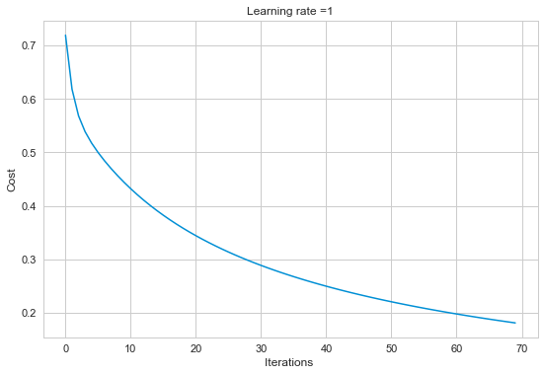
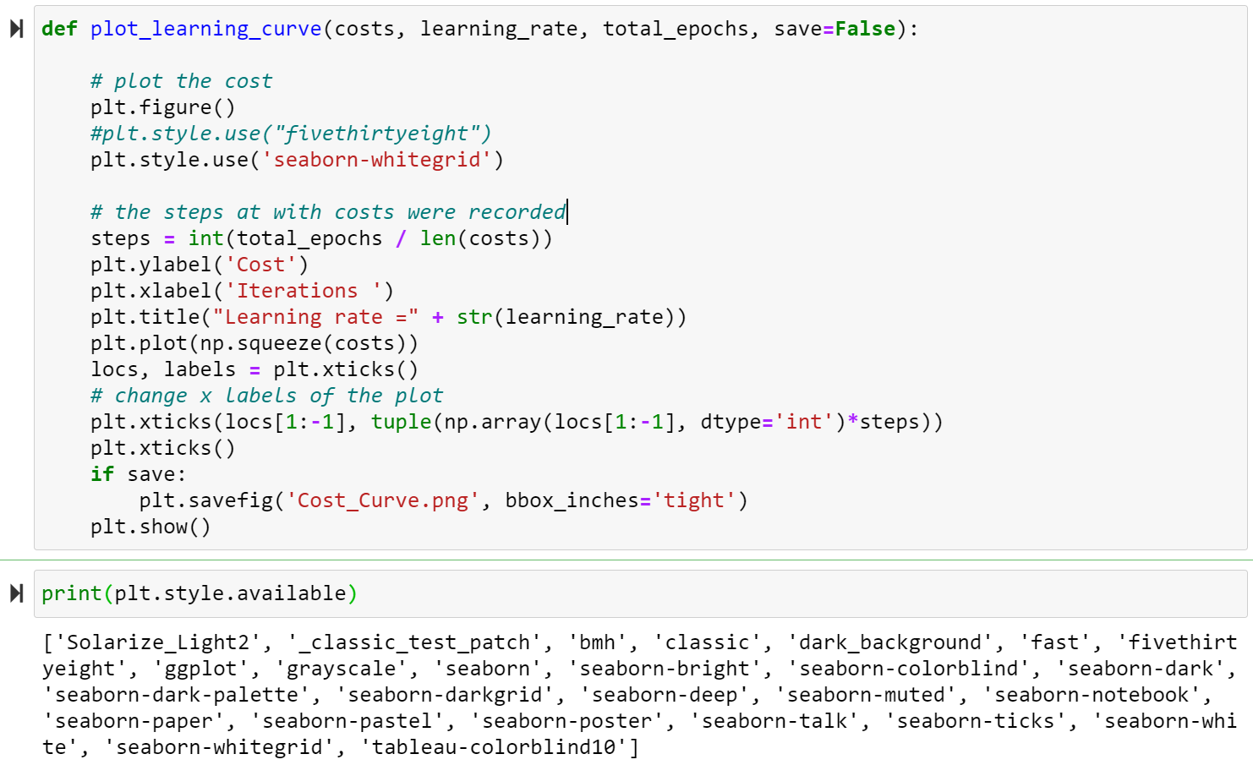
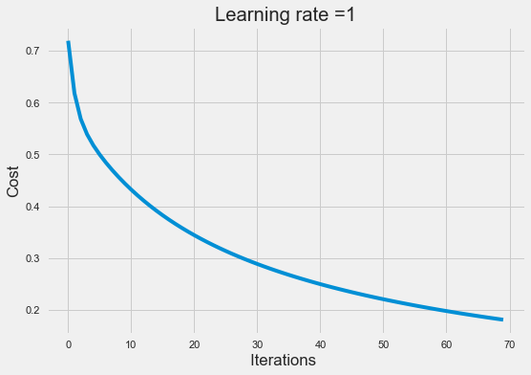
Data Visualisation: Plot Learning Curve
plt.style.use('seaborn-whitegrid')
plt.style.use("fivethirtyeight")

Slide 22
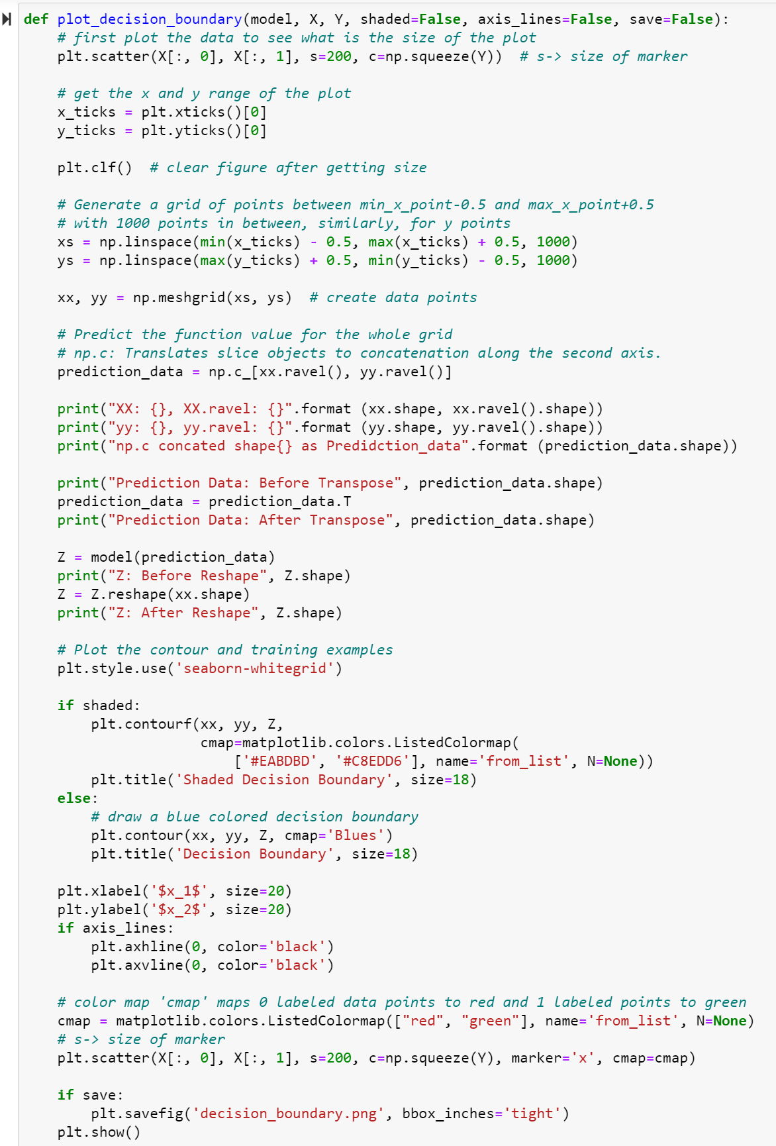
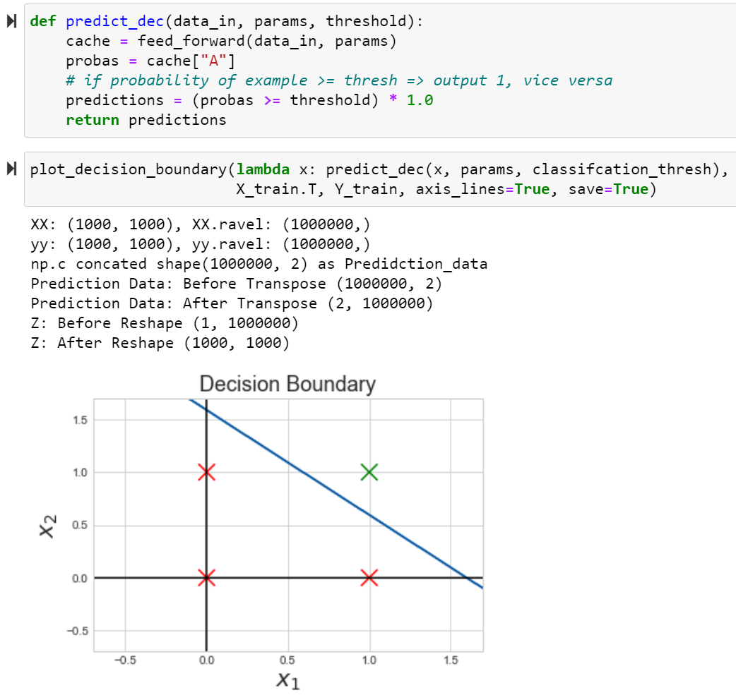
Data Visualisation: Plot Decision Boundary
Create data points for a 2D plane (x1, x2). These data points would be the input features for the prediction evaluation of the model.
The model with lambda command is used to call and pass the prediction data to the predict_dec function
np.c is used to concatenation the (x1,x2) along the axis, which created an array shape
[Examples * Features]
Decision boundary without shade

Slide 23
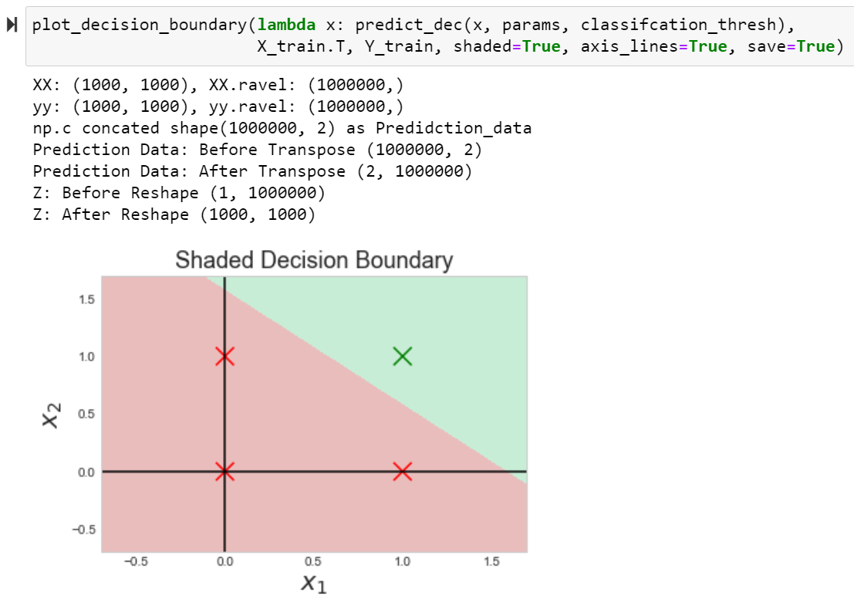
Data Visualisation: Plot Decision Boundary with Shaded Areas
Decision boundary with shade

Slide 24
Binary Classification: Wheat Seeds Dataset

Slide 25
Binary Classification: Wheat Seeds Dataset
This data was obtained from Kaggle (see Source). The dataset was originated from the ‘UCI Center for Machine Learning’ repository. It contains 7 variables for three distinct types of wheat kernels: (Kama, Rosa, Canadian) designated as numerical variables 1, 2 & 3 respectively. The 7 seed variables are:
Area
Perimeter
Compactness
Kernel Length
Kernel Width
Asymmetry Coefficient
Length of Kernel Groove
The last column is reserved for the Kernel type.
This original dataset has 199 entries. Some of these variables are explicitly dependent. For example, compactness: C = 4*pi*Area/(Perimeter)^2 has a linear proportional relationship with area, and also a square proportionality with kernel width.
For the purpose of this experiment, we have truncated the 3rd wheat kernel type, which makes this dataset contains only 2 types instead of 3 types.
In other words, the truncated dataset has 134 entries, and contains only 2 classes of kernel type, hence the dataset suitable for us to create a binary classifier using perceptron.
Our tasks:
Imports important libraries
Dataset analysis and visualisation
Pre-processing dataset for neural network learning
Neural network model setup and parameters initialisation
Hyper-parameters configuration and neural network training
Neural network prediction performance evaluation
Source: https://www.kaggle.com/jmcaro/machine-learning-classifiers-wheat-seeds?select=seeds.csv
Notes:
https://www.kaggle.com/jmcaro/machine-learning-classifiers-wheat-seeds?select=seeds.csv

Slide 26
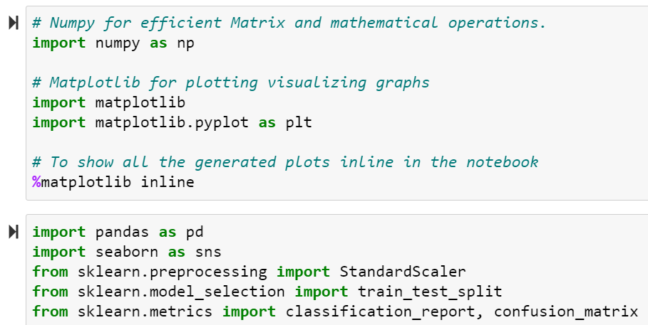
Imports important libraries
Besides the fundamental libraries e.g. NumPy, Matplotlib and Pyplot previously introduced, we need other libraries mainly to assist us in data loading, visualise and preparation for neural network training such as:
Pandas is a fast, powerful, flexible and easy to use open source data analysis and manipulation tool built on top of the Python programming language.
Seaborn is a Python data visualization library based on matplotlib. It provides a high-level interface for drawing attractive and informative statistical graphics.
Scikit-learn is an open source machine learning library that supports supervised and unsupervised learning. It also provides various tools for model fitting, data preprocessing, model selection and evaluation, and many other utilities.

Slide 27
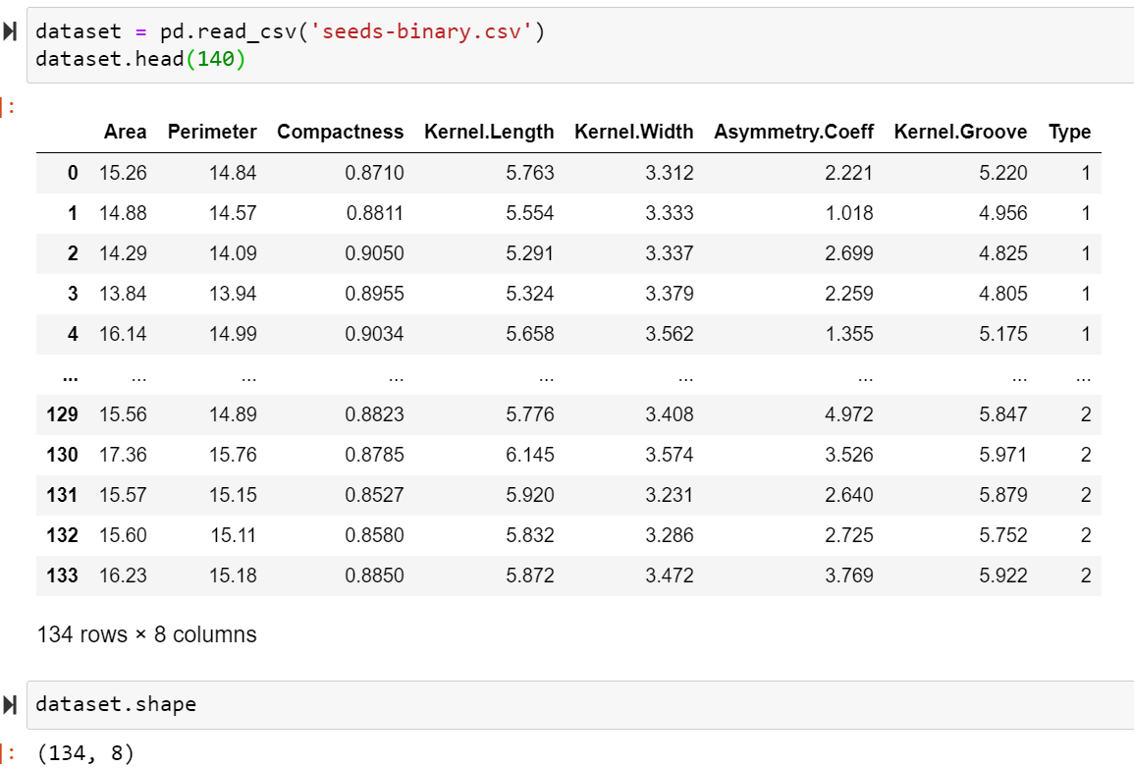
Dataset analysis and visualisation

Slide 28
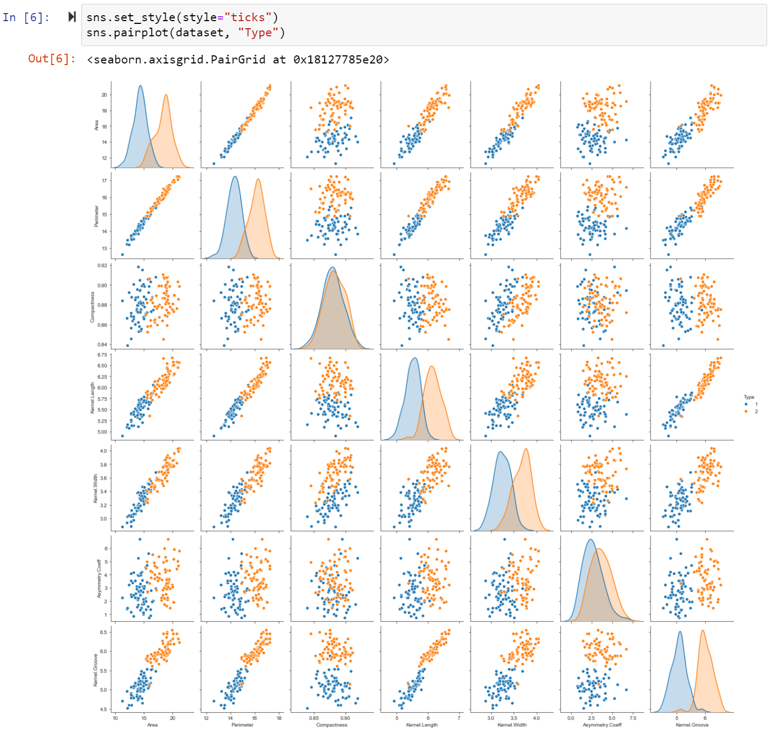
Dataset analysis and visualisation

Slide 29

Pre-processing dataset for neural network training

Slide 30

Pre-processing dataset for neural network training

Slide 31


Pre-processing dataset for neural network training
From sk-learn.preprocessing

Slide 32

Pre-processing dataset for neural network training
From sk-learn.model_selection
These are the expected input matrix shape ready for neural network training.

Slide 33


Neural network functions at a glance
Mathematically proven

Slide 34



Neural network model setup and parameter initialisation
7 features

Slide 35

Hyper-parameters configuration for neural network training

Slide 36


Neural network prediction: performance evaluation

Slide 37
End of Lesson

